Slide 1
IFS code validation and characterization
Maxime Rizzo
Neil Zimmerman
NASA GSFC
March 2017

Slide 2
Linear or log separation of wavelengths?
Tim Brandt’s CHARIS code uses a final wavelength array that is logarithmic instead of linear; need to ask why
Tried with both linear and log arrays, but will go with linear from now on
Assuming that dispersion is linear with wavelength
10 wavelength bins seems to accurately reproduce a flatfield

Slide 3
Why does it matter?
Wavelength array determines model PSFLet sampling on detector
Only matters for least-squares extraction, not really changes anything for optimal extraction
Residuals show an slight error in wavelength calibration, due to the sampling of PSFLets on the detector (that creates small shifts in centroids)
Residuals show ~1% effects, slightly more towards the edges of the image
It can probably all be made better with a much more careful image

Slide 4
Systematics
To make sure we trust the software, ran the code for fiducial inputs
Flatfield
Monochromatic wavelength
Doublets of monochromatic wavelengths
Realistic planetary albedo
Compare input vs output in noiseless scenarios

Slide 5
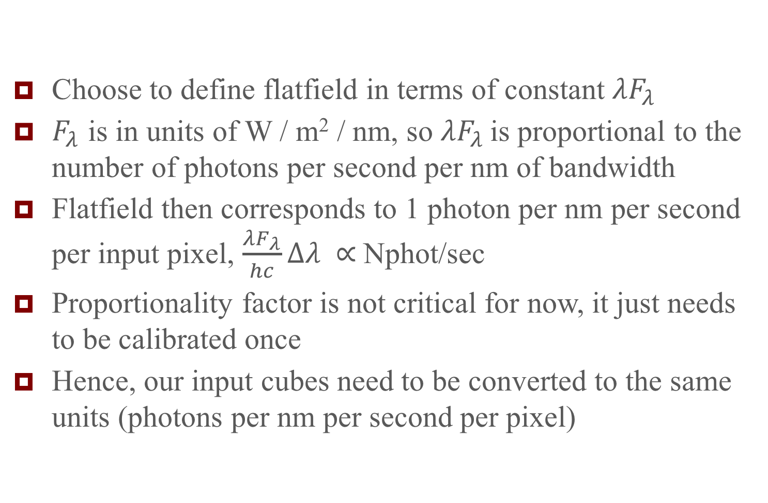
Flatfield
Choose to define flatfield in terms of constant $λF_{λ}$
$F_{λ}$ is in units of W / m² / nm, so $λF_{λ}$ is proportional to the number of photons per second per nm of bandwidth
Flatfield then corresponds to 1 photon per nm per second per input pixel, $\frac{λF_{λ}}{hc}Δλ ∝$Nphot/sec
Proportionality factor is not critical for now, it just needs to be calibrated once
Hence, our input cubes need to be converted to the same units (photons per nm per second per pixel)

Slide 6
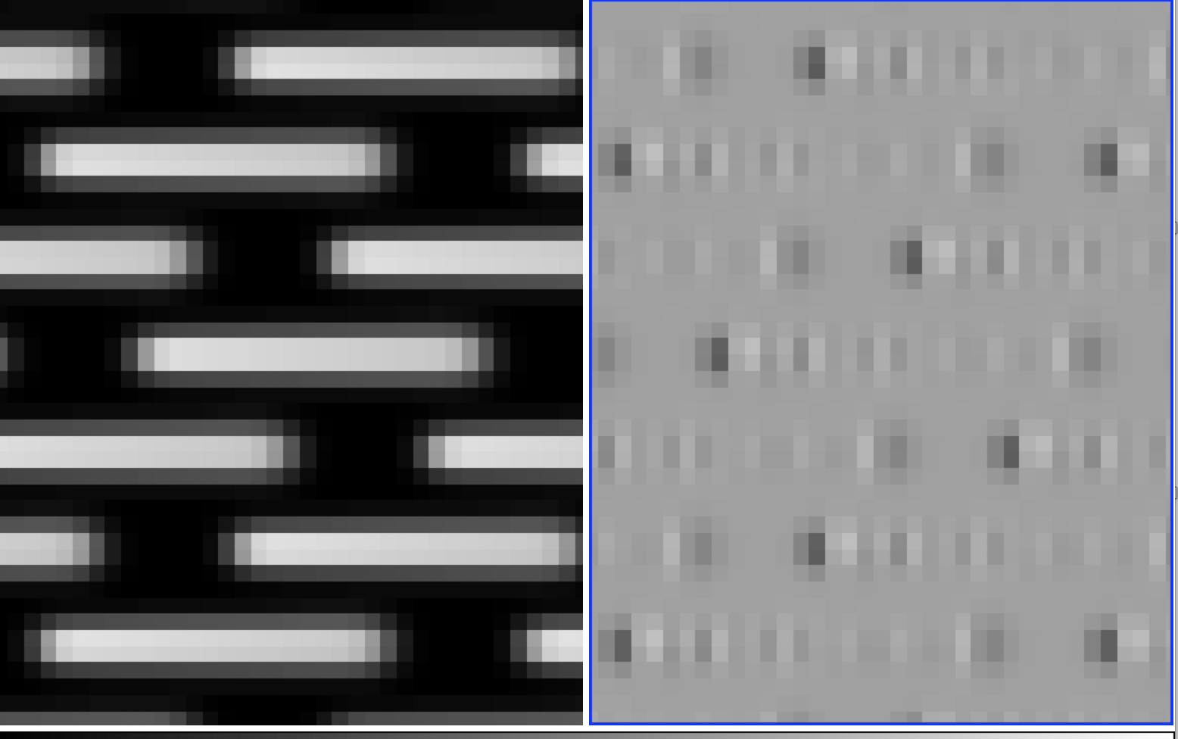
Flatfield residuals
Spectral edges: +/- 1-2%
Center of spectrum: <1%
Errors are systematic, so can be corrected with more efforts
Will divide all resulting cubes by this flatfield

Slide 7
Monochromatic wavelengths
Test to see what the instrumental response looks like

Slide 8
Start at 770nm

Slide 9
Start at 749nm

Slide 10
Optimal extraction
With 10 bins

Slide 11
Optimal extraction
With 18 bins

